Slide 1
LO: Discover an important rule about right angled triangles.
Use your Maths!
My patio is 4.8m long and 4m wide. I want to cover the patio with paving slabs. I buy 32 square slabs with side length 80cm. Do I have enough slabs to cover the patio?
The slabs cost £4.52 each. Work out the cost of 32 slabs.
Challenge
Write down all the maths topics you have used to solve this problem.
© NorledgeMaths

Slide 2
LO: Discover an important rule about right angled triangles.
How did you solve it?
© NorledgeMaths

Slide 3
LO: Discover an important rule about right angled triangles.
Work in groups of 3/4.
Cut out the three pages of triangles and squares carefully. Watch out for half and quarter squares.
Completely surround each triangle with three squares. Each square should fit exactly along the length of the triangle with no gap or overhang.
Your aim is to find the relationship between the three squares surrounding each triangle.
© NorledgeMaths

Slide 4
LO: Discover an important rule about right angled triangles.
The longest side is called the hypotenuse.
area = a × a = a²
h
area = h × h = h²
a
b
area = b × b = b²
a² + b² = h²
© NorledgeMaths

Slide 5
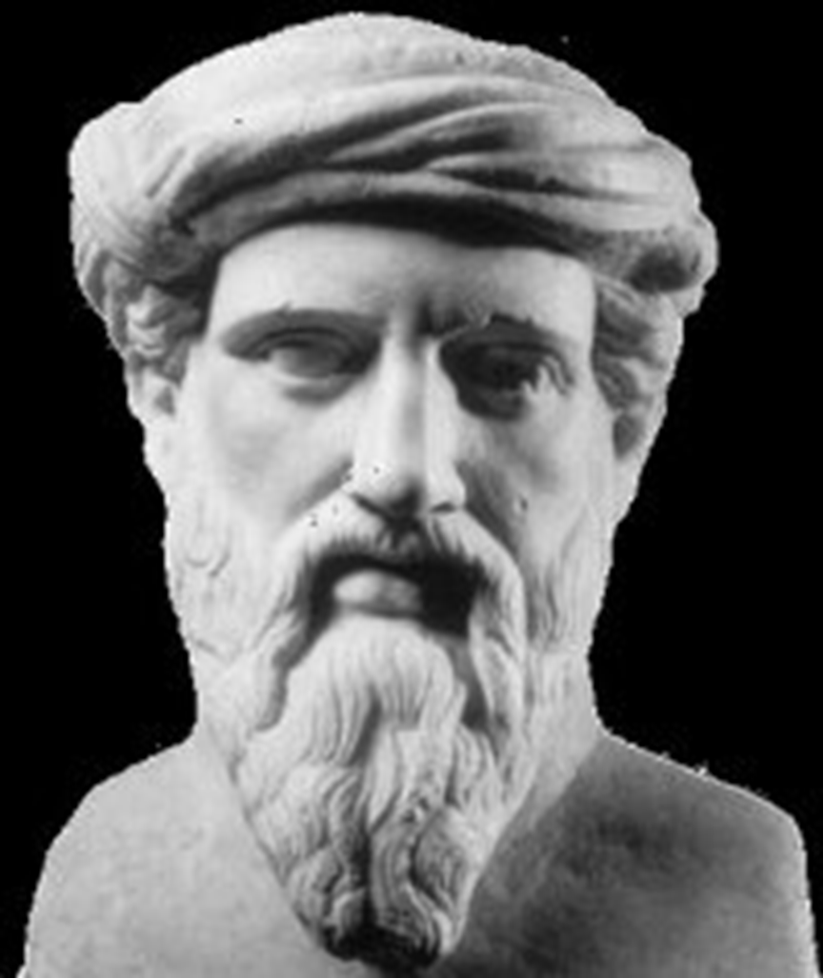
LO: Discover an important rule about right angled triangles.
Who was Pythagoras?
c. 570 BC to c. 495 BC
Ancient Greek
Founded a religion (Pythagorianism)
Probably didn’t discover or prove “Pythagoras’ Theorem” himself…
© NorledgeMaths

Slide 6
LO: Discover an important rule about right angled triangles.
How he (apparently) discovered his theorem…
© NorledgeMaths

Slide 7
LO: Discover an important rule about right angled triangles.
Try this problem:
Find the value of x.
x
5cm
12cm
© NorledgeMaths

